Slide 1
Protein Structure Alignment by Incremental Combinatorial
Extension (CE) of the Optimal Path
Ilya N. Shindyalov and Philip E. Bourne,
Protein Engineering vol.11 no.9 pp.739-747, 1998
Presenter : Hsiao-Yen Chang
Data : December 14, 2006

Slide 2
Abstract
A new algorithm is reported which builds an alignment
between two protein structures. The algorithm involves
a combinatorial extension (CE) of an alignment path
defined by aligned fragment pairs (AFPs) rather than
the more conventional techniques using dynamic
programming and Monte Carlo optimization. AFPs, as
the name suggests, are pairs of fragments, one from
each protein, which confer structure similarity. AFPs
are based on local geometry, rather than global
features such as orientation of secondary structures
and overall topology. Combinations of AFPs that
represent possible continuous alignment paths are
selectively extended or discarded thereby leading to a
single optimal alignment.

Slide 3
The algorithm is fast and accurate in finding an optimal
structure alignment and hence suitable for database
scanning and detailed analysis of large protein families.
The method has been tested and compared with
results from Dali and VAST using a representative
sample of similar structures. Several new structural
similarities not detected by these other methods are
reported. Specific one-on-one alignments and searches
against all structures as found in the Protein Data Bank
(PDB) can be performed via the Web at
http://cl.sdsc.edu/ce.html.

Slide 4
The CE Algorithm
Goal: Find a “good” local alignment for structures of proteins A and B.
Basic idea
  Select some initial AFP.
  Build an alignment path by incrementally adding AFPs in a way that satisfies the conditions on the previous slide.
  Repeat step (2) until the length of each protein is traversed, or until no “good” AFPs remain.
  To assess the significance of the alignment, compare it to the alignment of a random pairs of structures, and compute the Z-score based on the RMSD and number of gaps in the final alignment.
Algorithm Specifics
  How do we choose the starting AFP?
  What are the criteria for adding AFPs to our alignment path?
  How do we know when to stop?

Slide 5
Aligned Fragment Pair (AFPs)
AFP is a pair of segments that have similar structures.
versus
2
3
4
1
1
2
3
4

Slide 6
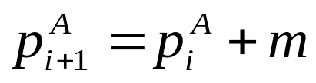
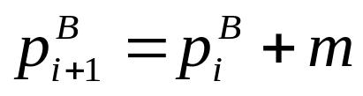
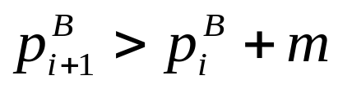

Definition of the alignment path
The alignment between two protein structures A and B of length n^{A} and n^{B}, respectively, the longest continuous path P of AFPs of size m.
for every two consecutive AFPs i and i+1 in the alignment path:
and
and
and
where p_{i}^{A} is the AFP’s starting residue position in protein A at the ith position in the alignment path; similarly for p_{i}^{B} .

Slide 7
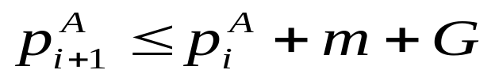
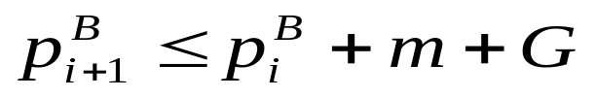
Combinatorial extension of the alignment path
The alignment path is constructed from AFPs of fixed size m (8 is a reasonable choice as shown empirically).
and
where G is the maximum allowable size of the gap (30 is a reasonable choice as determined empirically).

Slide 8
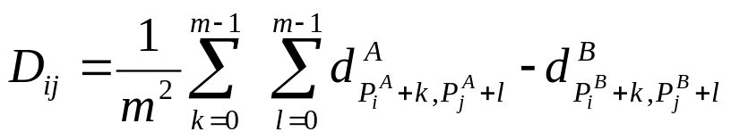
Heuristics for similarity evaluation and path extension
Distance measure (i) is used to evaluate the combination of two AFPs, one already in the alignment path and one to be added.
Distance measure (ii) is used to evaluate a single AFP, i.e., how well two protein fragments forming an AFP match each other.
Distance measure (iii) is used as the last step in selecting the few best alignments and for optimizing gaps in the final alignment. --- rmsd

Slide 9
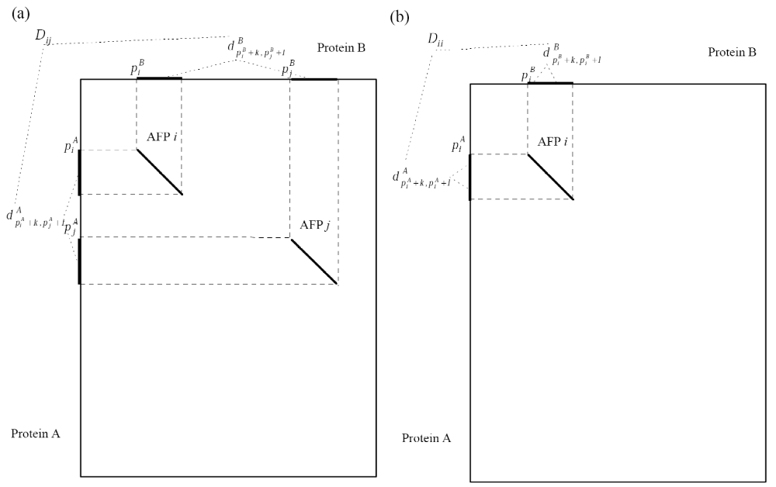

Slide 10
selection of starting point for the alignment path
We normally consider all possible starting points in the similarity matrix S which satisfy the similarity criteria. In searching for the alignment of maximum length, all starting points not leading to an alignment of length greater than the length of the longest alignment found thus far are discarded. This saves computational time, but limits matches to one per polypeptide chain.
The longest alignment path is now evaluated for statistical significance (represented as a z-score).

Slide 11
Z-score
The z-score of a particular alignment (z) is calculated by numerically solving equation 8 for z using a normal distribution with an average value of 0 and a standard deviation of 1:
ρ (0,1,-z) =ρ(D_{i}^{av} ,D_{i}^{sd} ,D^{obs} ) ρ(G_{i}^{av} ,G_{i}^{sd} ,G^{obs} ) (8)
i is the number of the AFPs in the alignment path
D^{obs} , G^{obs} is the observed distance score (according to equation 11) and number of gaps for the alignment path under consideration, respectively.
D_{i}^{av} ,D_{i}^{sd} is the sample average and standard deviation, respectively for the distance score for paths of length i in a random comparison of structures taken using a variety of polypeptide chains and starting points.
G_{i}^{av} ,G_{i}^{sd} is the sample average and standard deviation, respectively for the gap score for paths of length i in a random comparison of structures.

Slide 12
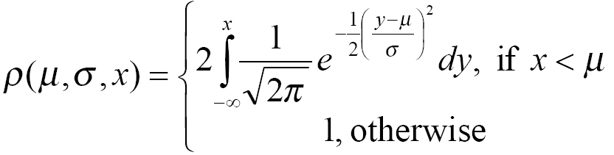
Z-score
z is the z-score of alignment

Slide 13

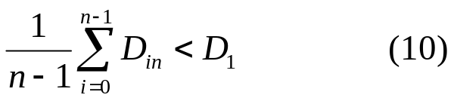
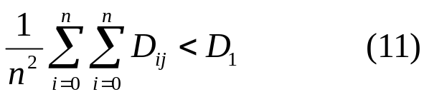
It was shown empirically that the most accurate alignment occurs when the selection of the best AFP and extension of path is done in three steps:
  (i) all candidate AFPs are selected based on condition 9;
  (ii) the best AFP is chosen based on condition 10;
  and (iii) the decision to extend or terminate the path is made based on condition 11.
  where D_{ij} is the distance between aligned fragments defined by the AFPs i and j in the alignment path and n is the next AFP to be considered for addition to the alignment path of n-1 AFPs in length. D₀ and D₁ are similarity thresholds with typical values of D₀=3Å and D₁=4Å.

Slide 14
Optimization of the final path
(i) the 20 best paths at the end of the search are evaluated based upon rmsd and the best one selected;
(ii) each gap in this single alignment is evaluated for possible relocation in both directions up to m/2 positions, where m is the AFP size, and if the rmsd of superimposed structures (Hendrickson, 1979) indicates improvement, then modified gap boundaries are adopted;
and (iii) iterative optimization using dynamic programming (Needleman and Wunch, 1970) is performed on the distance matrix calculated using residues from the two superimposed structures.

Slide 15
Optimization of the final path
The gap penalty is 5 for initiation and 0.5 for extension with the elements of the distance matrix M_{ij} =d₀-d_{ij}, where d₀ - is a constant at every optimization cycle. Optimization begins at d₀=2 and d₀ is incremented by 0.5 in every cycle.
Optimization continue until either of two conditions is satisfied:
  (i) alignment length is less than 95% of alignment length before optimization;
  (ii) rmsd is less than 110% of rmsd at the cycle when condition i was first satisfied.

Slide 16
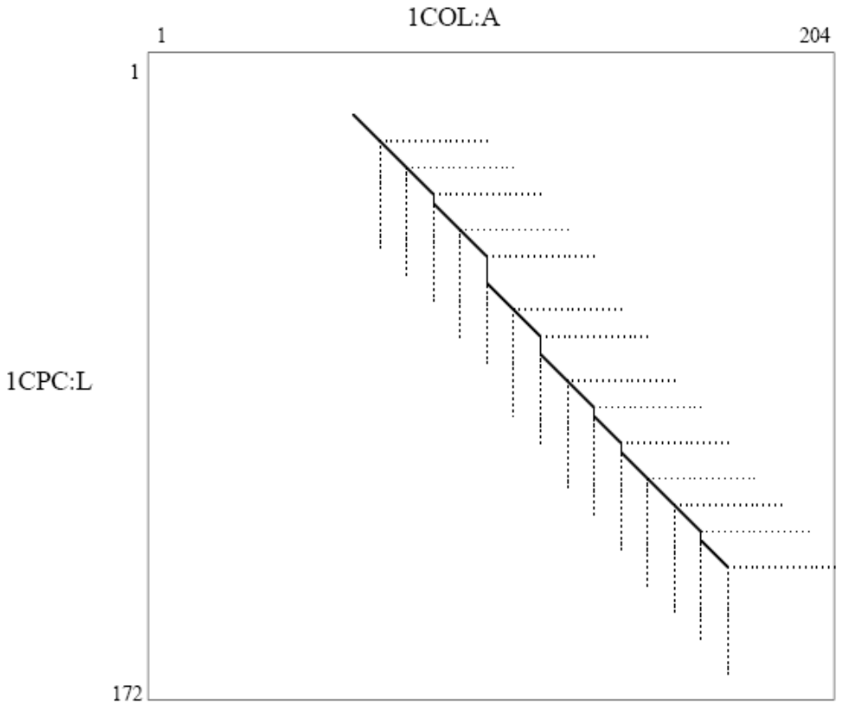
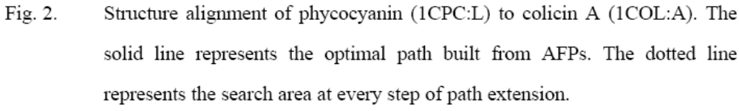
Test case: Phycocyanin vs. Colicin A

Slide 17
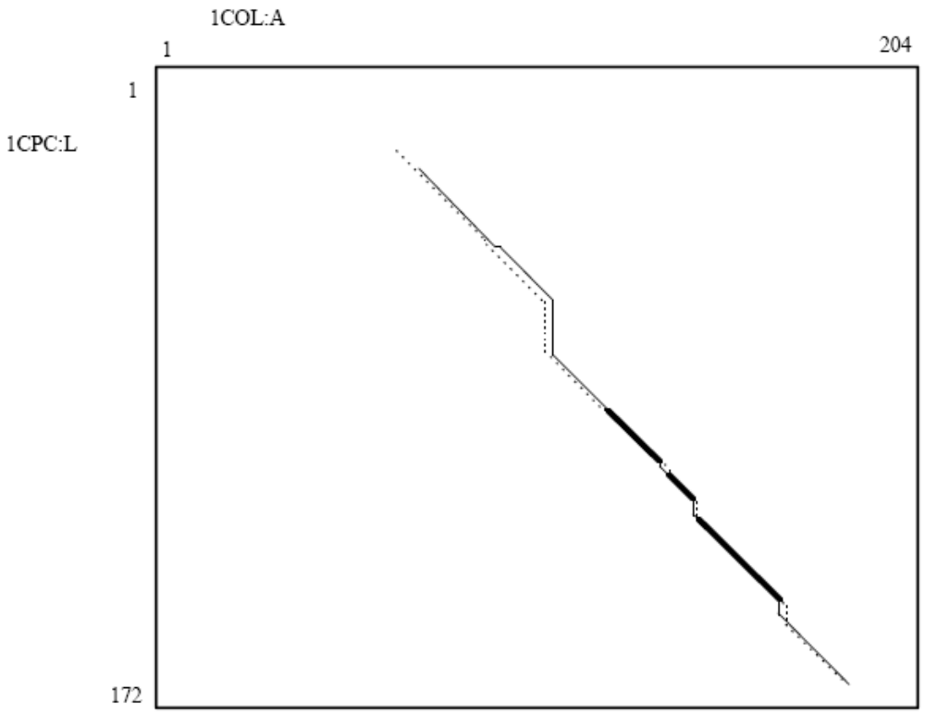
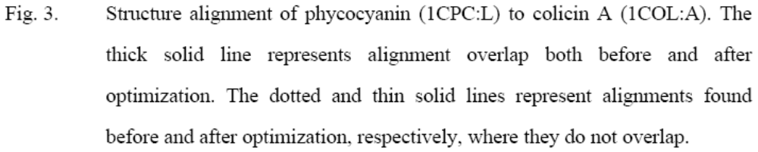

Slide 18
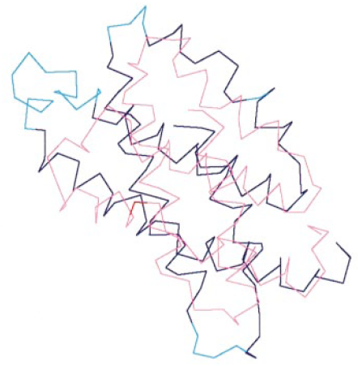
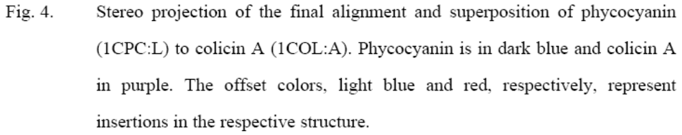

Slide 19
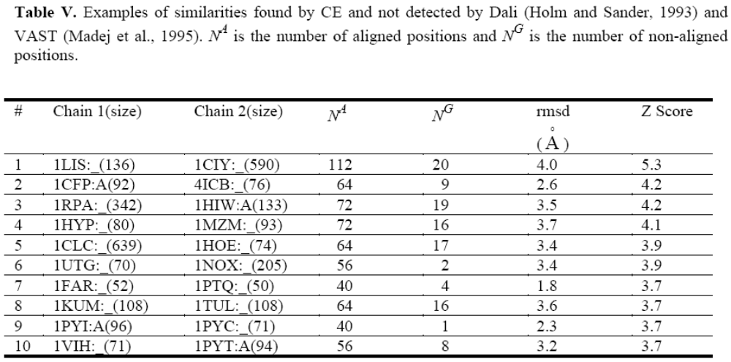
Comparison with other Web accessible 3-D structure comparison methods: Dali and VAST

Slide 20
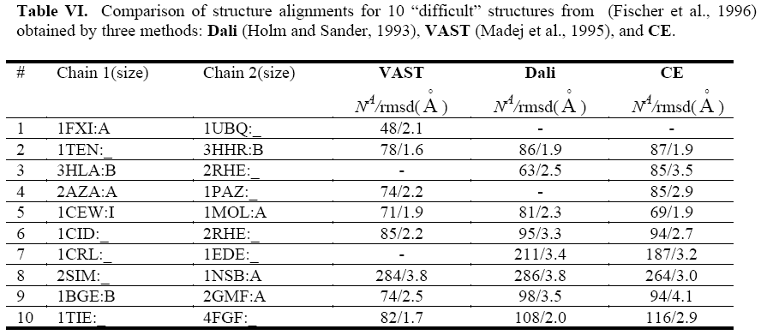
Comparison with other Web accessible 3-D structure comparison methods: Dali and VAST

